Slide 1
DATA ANALYTICS AND COGNOS
Product sales Analysis
Summited by:
v.vasanth

Slide 2
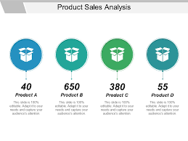

Slide 3
HOW TO WRITE SALES REPORT
Know the purpose of your sales report
Tailor your sales report to your audience
Determine your sales reporting timeframe
Get your sales data
Explain key insights from your data sales
Use visuals to show vital sales trends and metrics

Slide 4
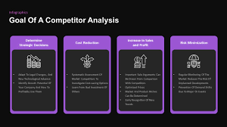

Slide 5
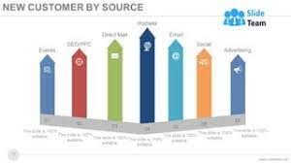

Slide 6
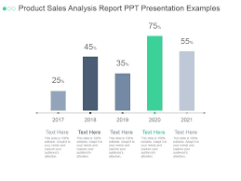

Slide 7
CONCLUSION:
Sales team should not only sell more,but also concentrate on selling more of product that have a higher gross margin.

